Slide 1
Materials Manufacturing (EDPT 601)
Tutorial 3 ( Bulk deformation Processes)
By: Eng. Sherifa Taher

Slide 2
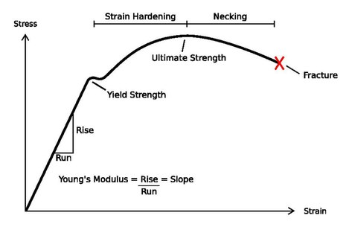
Metal Forming
A forming operation is one in which the shape of a metal sample is altered or changed by subjecting the metal to plastic deformation.
When the metal is subjected to external compressive forces or stresses exceeding the yield stress of the material, it undergoes plastic deformation, where the metal can not regain its original shape.
Typical stress strain curve for
ductile materials

Slide 3
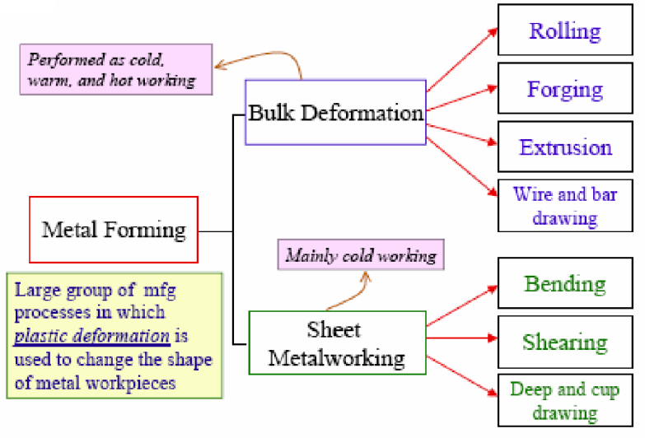
Classification of metal forming processes

Slide 4
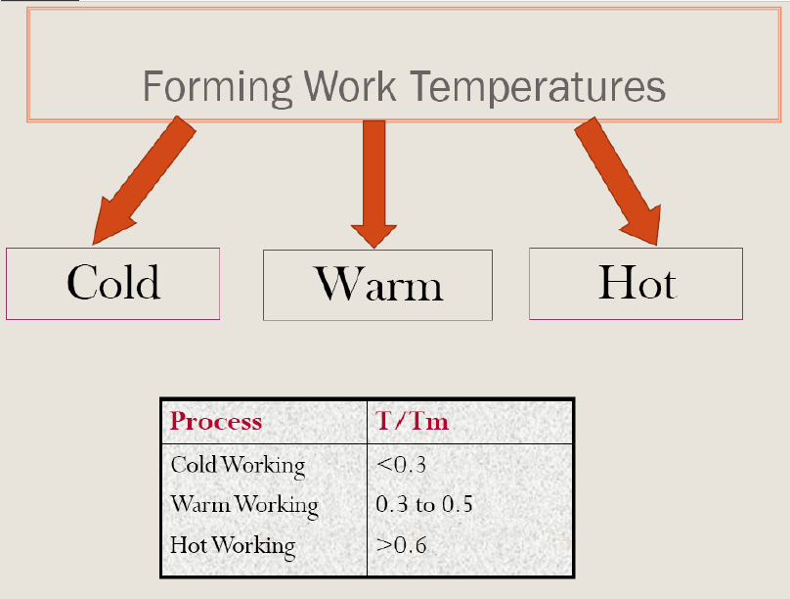
Tm: Melting temp. (K)

Slide 5
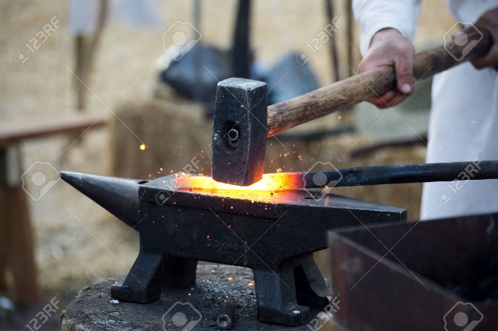
Bulk Deformation Processes
Forging
Forging can be defined as a manufacturing process involving the shaping of metal using localized compressive forces.
Traditionally, forging was performed using hammer and anvil.
In modern times, industrial forging is done either with presses or with hammers powered by compressed air, electricity, hydraulics or steam.
Types of forging : Open die forging and closed die forging.

Slide 6
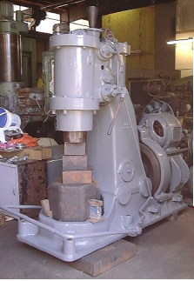
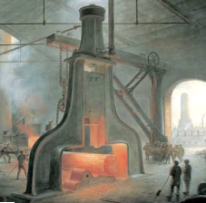
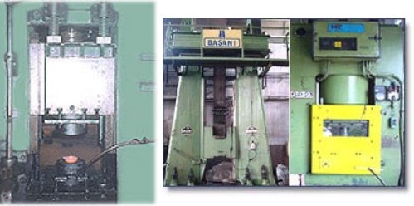
Hammers and Presses used in forging
Basic types of hammers (Board and power)
Basic types of presses ( Mechanical and hydraulic)

Slide 7
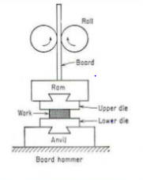
Principle operation of board hammer
The upper die and ram are raised by friction rolls gripping the board.
After releasing the board, the ram falls under gravity to produce blow energy.
The hammer can strike between 60-150 blows per minute depending on size and capacity.
The blow energy supplied is equal to the potential energy due to the weight and the height of the fall.
Blow energy = potential energy = mgh
This energy will be delivered to the metal workpiece to produce plastic deformation.

Slide 8
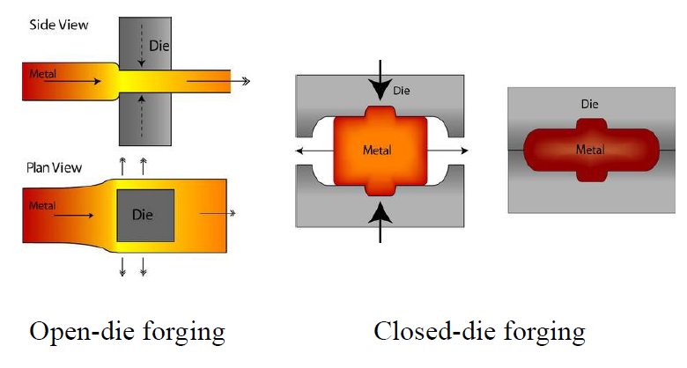
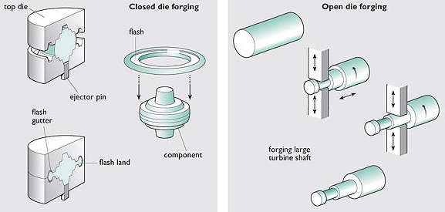
Open and closed die forging

Slide 9
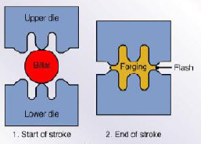
Drop forging
Drop forging is a forging process where a hammer is raised and then "dropped" onto the workpiece to deform it according to the shape of the die. There are two types of drop forging: open-die drop forging and closed-die drop forging.
Open-die forging gets its name from the fact that the dies do not enclose the workpiece, allowing it to flow except where contacted by the dies.
In Closed-die forging, the metal is placed in a die resembling a mold. The hammer is then dropped on the workpiece, causing the metal to flow and fill the die cavities and excess metal is squeezed out of the die cavities, forming what is referred to as flash.

Slide 10
Press forging and upsetting
Press Forging:
Press forging works by slowly applying a continuous pressure or force, which differs from the near-instantaneous impact of drop-hammer forging.
Press forging can be used to perform all types of forging, including open-die and impression (closed) die forging.
Upsetting:
Upset forging increases the diameter of the workpiece by compressing its length.
A few examples of common parts produced using upsetting are engine valves, bolts, screws, and other fasteners.

Slide 11
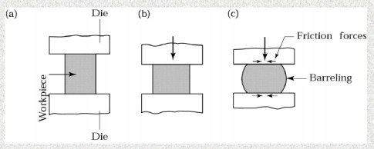
Barreling in open die forging
Barreling is caused primarily by frictional forces at the die-work-piece interfaces that oppose the outward flow of the materials at these interfaces. Barreling can be minimized by using an effective Lubricant.
Barreling can also occur in upsetting hot work-pieces between cold dies. The material at and near the interfaces cools rapidly, while the rest of the work-piece remains relatively hot. Thus, the material at the ends of the work-piece has higher resistance to deformation than the material at its center. Consequently, the central portion of the work-piece expands laterally to a greater extent than do its ends.
Barreling from thermal effects can be reduced or eliminated by using heated dies.

Slide 12
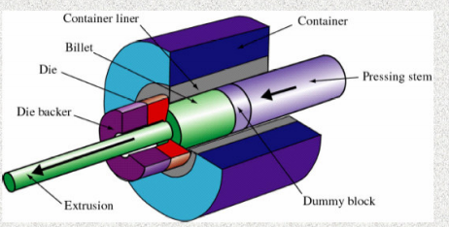
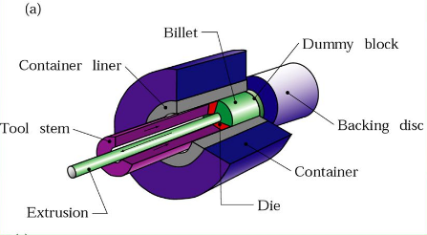
2. Extrusion
A cylindrical billet is placed in a chamber and forced through a die opening in various cross sections, by a hydraulically driven ram or pressing stem.
Types of extrusion (Direct and indirect extrusion).

Slide 13
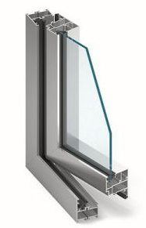
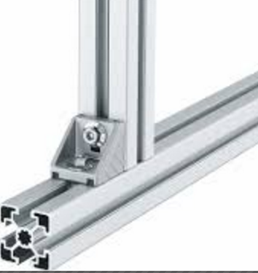
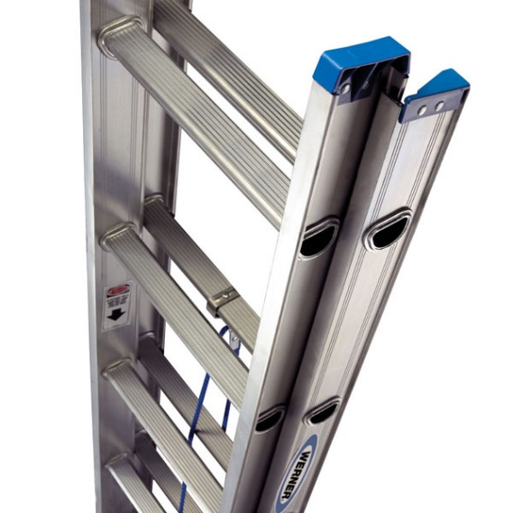
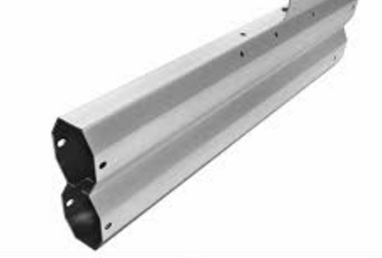
Extruded products
Window frames
Tubes with various cross sections
Aluminum ladders

Slide 14
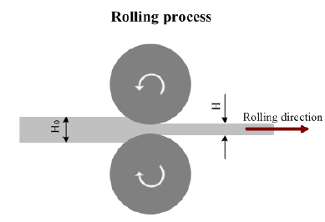
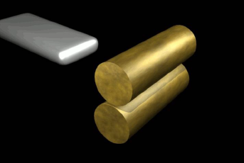
3. Rolling
Rolling is the process of reduction of the cross sectional area or shaping of a metal workpiece through the deformation caused by a pair of metal rolls that rotate in opposite direction.
A friction force is required in order to bite the bar and pull it through the rolls, therefore the gap between the rotating rolls is less than the thickness of the entering bar.
The metal bar passing through the rotating rolls is squeezed and elongates while its cross sectional area decreases.

